Slide 1
Optimizing Superhero U’s Facebook Ad Campaigns: A Financial Analysis
Marketing Team Performance Review and Recommendations
Prepared by: DVT Team 7
Date: May 26, 2025

Slide 2
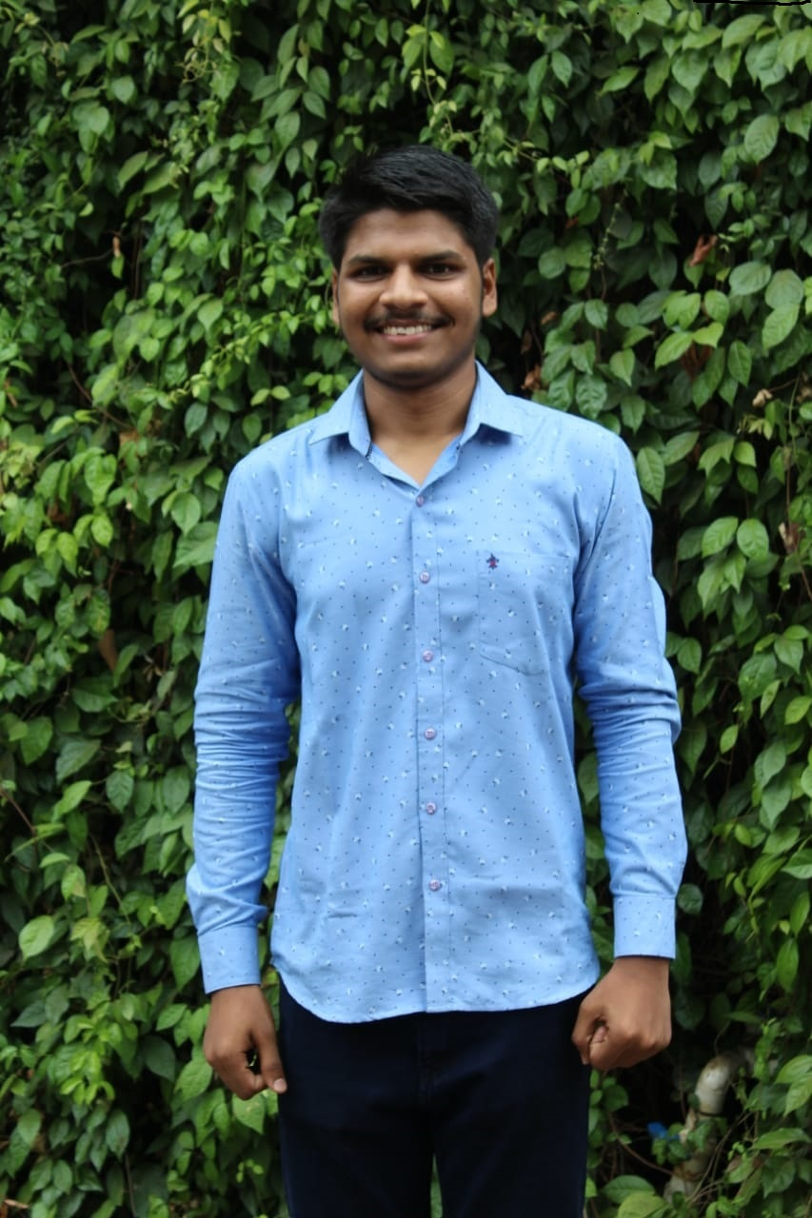
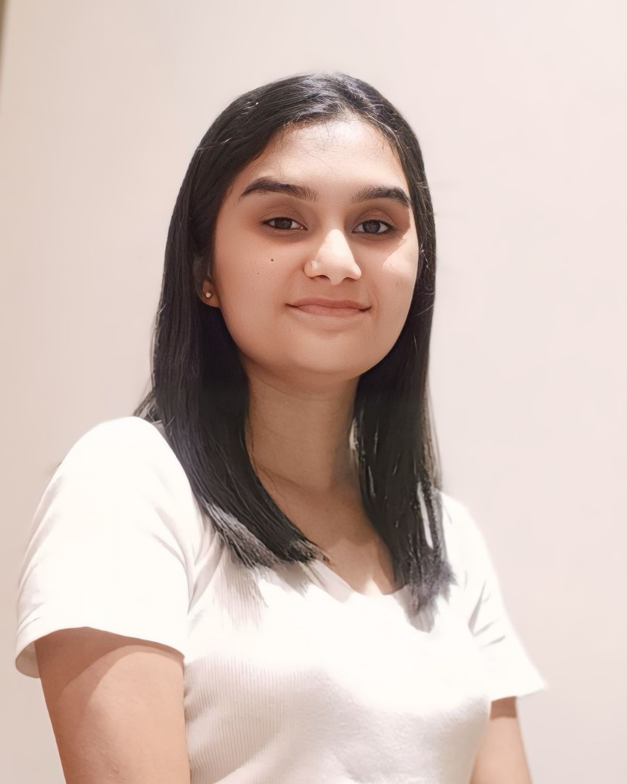
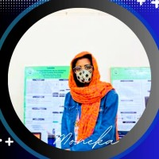
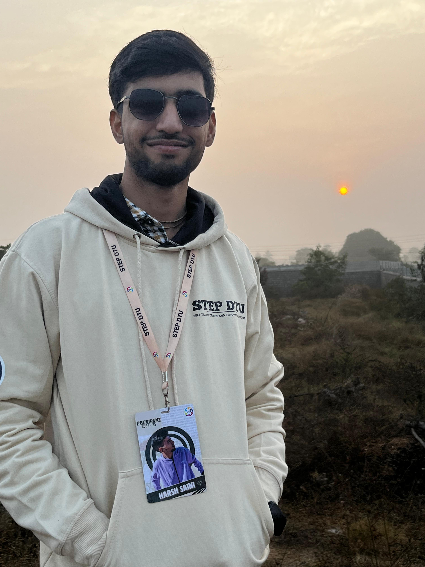

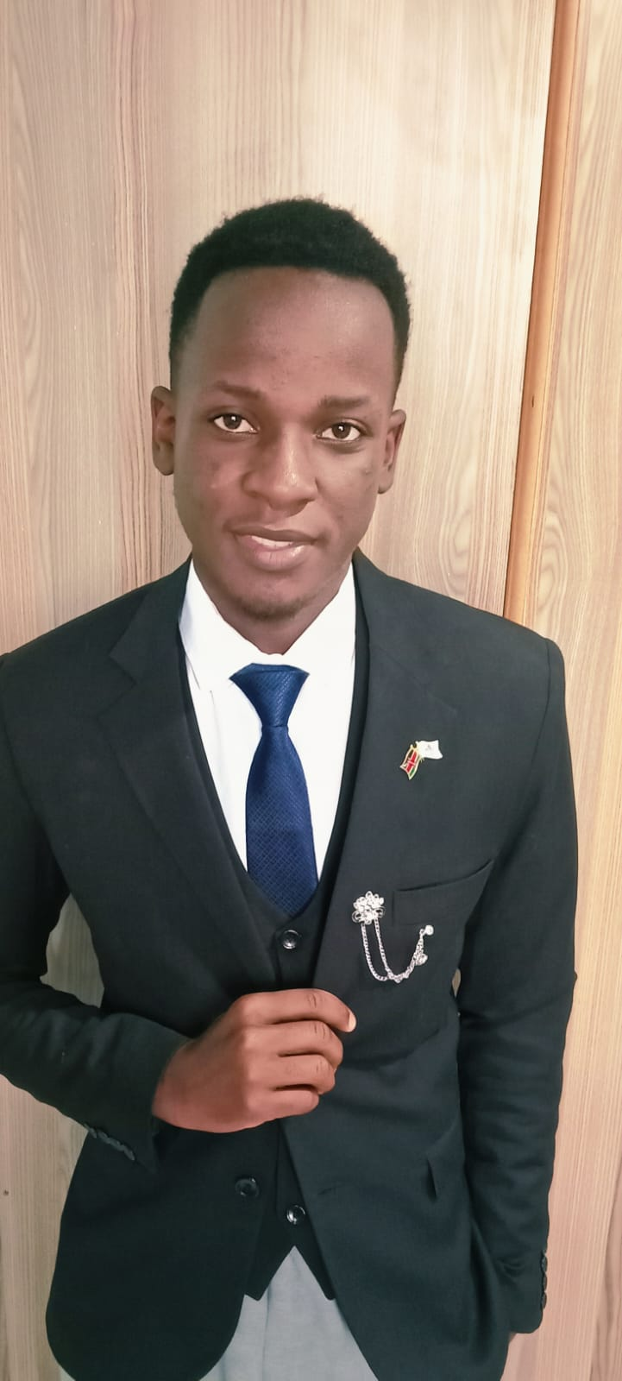
Meet the DVT Team 7
We are the Data Analyst Team, tasked with evaluating the performance of Superhero U’s Facebook ad campaign. Our goal is to provide actionable insights to optimize ad spend for better ROI.
Tejas Bhasme
Team Lead
Dhanshree Wasankar
Project Manager
Moneka Meghwar
Project Lead
Harsh Saini
Project Lead
Yash Vyas
Project Scribe
Sydney Husting
Asst Project Scribe

Slide 3
Superhero U: Fostering Youth Innovation
Superhero U Event
Showcasing Brilliance
Inspiring Tomorrow’s Heroes
Empowering youth with innovation- Superhero U. Where young minds create superheroes to tackle real-world issues guided by UN’s SDGs.
Divided into the high school and college categories, Superhero U was conducted in three rounds – preliminary, semi-final and final
Equal educational opportunities for imaginative youth, encouraging solutions for global challenges.

Slide 4

Facebook offers many opportunities to promote content via its Advertising platform and page post link ads can help you drive more traffic to your content.
Analysing Facebook Ads
Facebooks ads are paid posts that businesses use to promote their products or services or Facebook users. Facebook ads can be text, image or video.
Facebook ads are a popular way for marketers to reach customers. They can be used to promote a business page, posts, actions, or websites.

Slide 5
Superhero U ad Campaign Overview
Campaign ID | Campaign Name | Audience
Campaign 1 | SHU_6 (Educators and Principals) | Educators and Principals
Campaign 2 | SHU3_ (Students Apart from India and US) | Students
Campaign 3 | SHU_Students(Australia) | Students
Campaign 4 | SHU_Students (Canada) | Students
Campaign 5 | SHU_Students(Ghana) | Students
Campaign 6 | SHU_Students (India) | Students
Campaign 7 | SHU_Students(Nepal) | Students
Campaign 8 | SHU_Students (Nigeria) | Students
Campaign 9 | SHU_Students(UAE) | Students
Campaign 10 | SHU_Students(UK) | Students
Campaign 11 | SHU_Students (USA) | Students

Slide 6
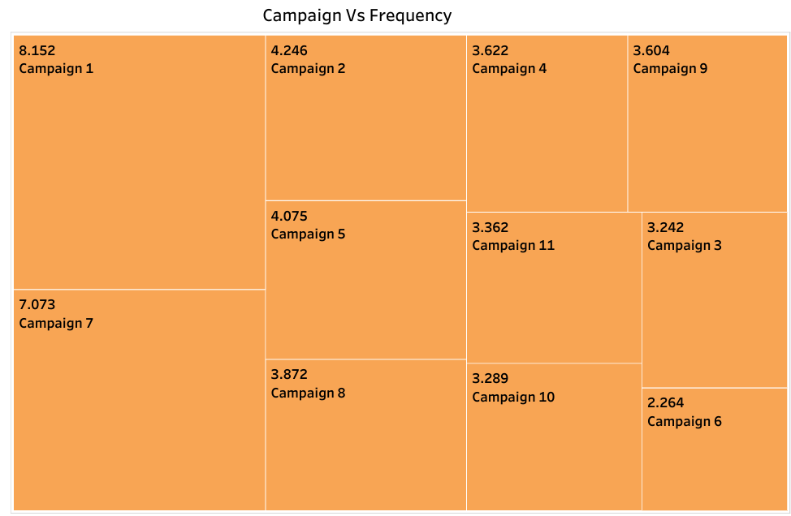
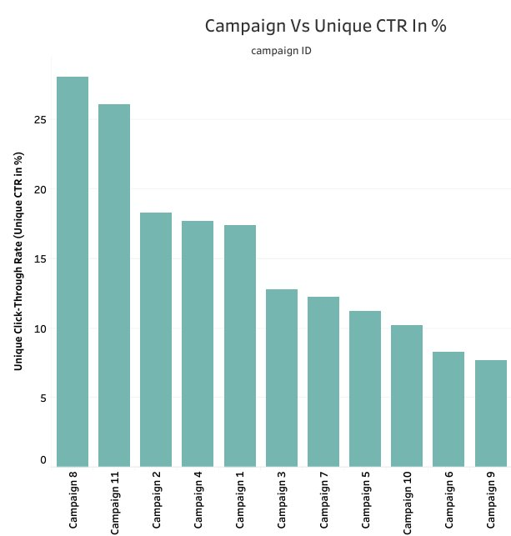
Data Visualization

Slide 7
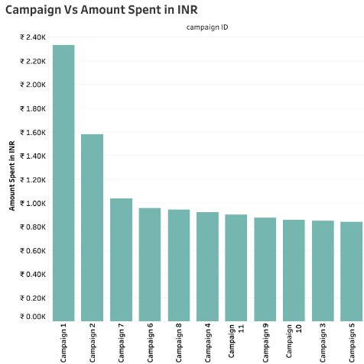
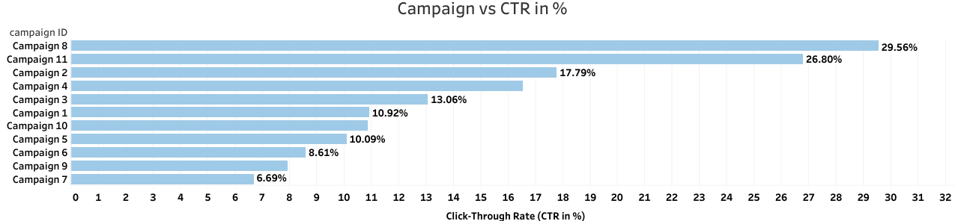

Slide 8
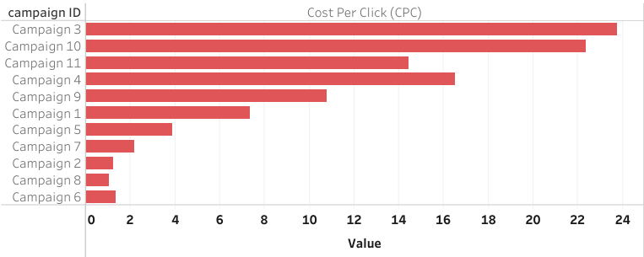
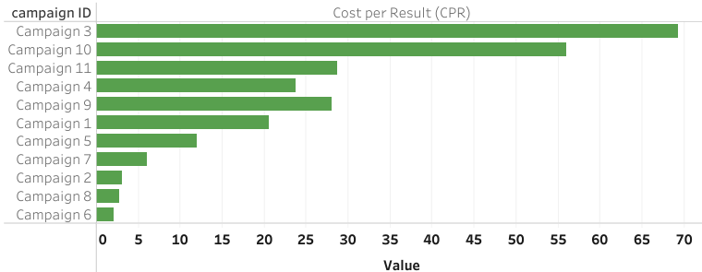

Slide 9
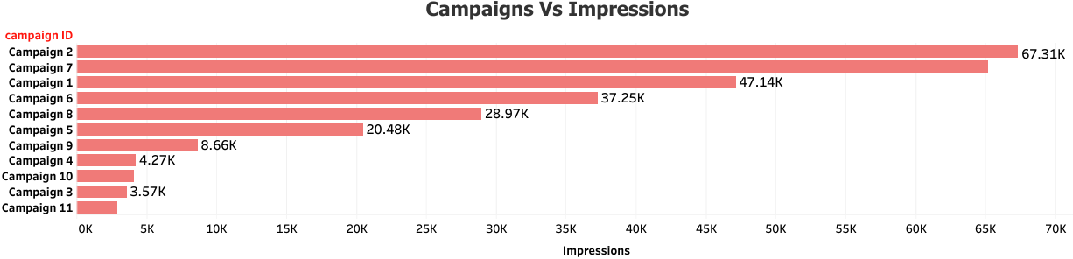
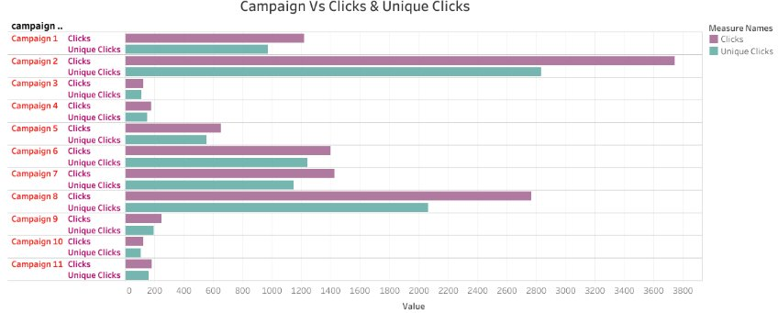

Slide 10
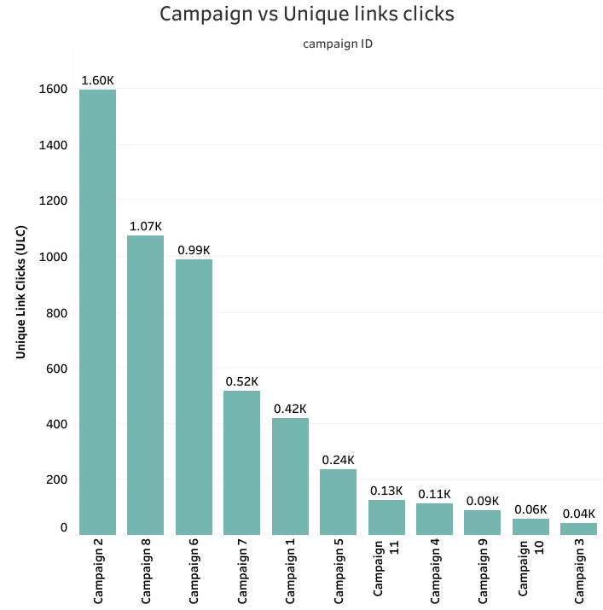
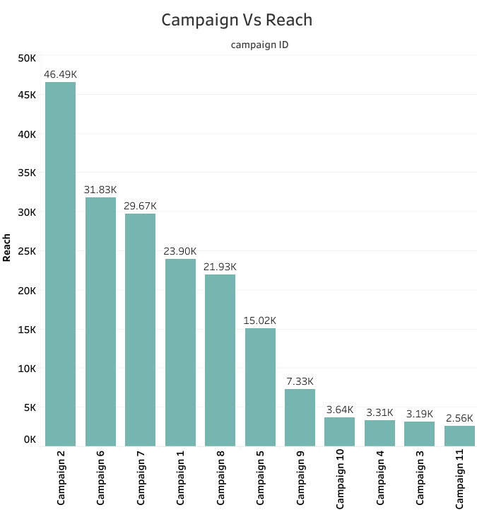

Slide 11
Conclusion:
After analyzing the 11 Superhero U campaigns, we recommend discontinuing the following due to their high CPC, high CPR, indicating poor cost-effectiveness:
Campaign 3 (Australia): Highest CPC (INR 23.76), highest CPR (INR 69.32), CTR (13.06% - moderate but overshadowed by cost), Reach 3,187 (lowest impact).
Campaign 10 (UK): Second highest CPC (INR 22.36), high CPR (INR 55.95) but misleading due to low Reach of 3,636(second lowest), CTR 10.88% (low relative to cost), low overall impact.
Redirecting budget to high-performing campaigns like Campaign 6 (India) (CPC: INR 1.35, Reach: 31,831) and Campaign 2 (Group 2) (CPC: INR 1.24, Reach: 46,494), which show lower costs and higher engagement, will optimize ROI.
Next Steps: Reallocate funds to top-performing campaigns and monitor performance over the next 30 days to ensure continued improvement.

Slide 12
THANK YOU

